Slide 1
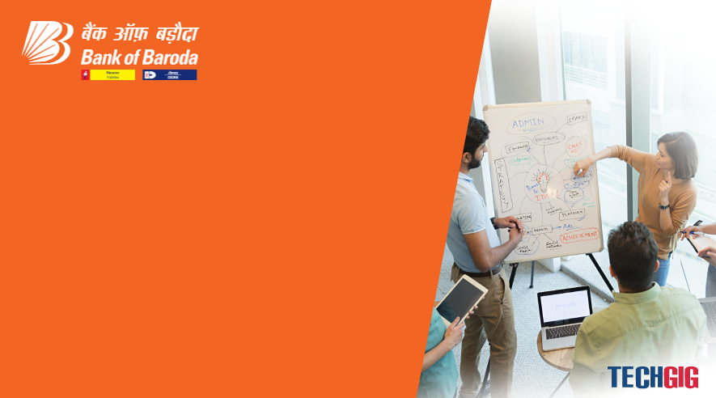

Bank of Baroda Hackathon - 2022
Technology Partner
Our Team Name : Money Heist
Team Bio :
We are a group of 4 students pursuing 3rd year of Electronics and Communication Engineering, in St.Joseph’s College of Engineering , Chennai. Among us two of us are equipped with MATLAB and coding skills and two of them have the knowledge about Image Processing.One among us has excellent coding(python) skills.
Date:20/09/2022

Slide 2
Problem Statement
Banks are using video cameras for the purpose of surveillance at many branches, ATMs and digital lobbies. Getting video analytics of different parameters from the video recording will help the bank to resolve many operational issues at the branches. The bank wants to explore video analytics to understand the customer sentiments, understand the patterns /behaviors/actions in certain branches for proactive surveillance and provide better services to customers.
Why did you decide to solve this Problem statement?
We decided to solve this statement because I have been to banks , not most of the people come there with a simling face. They may be with frustration, agony but no one notices these emotions .In situations even I have been to banks with frustration and agony.
Since, I have seen myself and many others in this state of mind in the banks ,this is our initial and main motive to provide a solution to this problem statement. Bank’s reputation increases by not only giving attention to the customers but also by giving extra attention to the customer’s emotions.
Since also the number of Bank robberies(4386) in a year are increasing gradually every year we have decided to give a solution to reduce the number of robberies by alerting the bank authority.
Customers will feel more comfortable coming to bank when their emotions are prioritized and their needs are satisified.

Slide 3
User Segment & Pain Points
The early adopters are as follows:-
Bank of Baroda -Head Quarters
Bank of Baroda metropolitan Branches- 1,774 Branches
Bank of Baroda other branches(Urban,semi-urban,rural,domestic) - 6440 Branches
Bank of Baroda Bank ATM’s - 10,033 ATM
Bank of Baroda (Foreign Branches) – 94 Branches
Other Banks

Slide 4
Pre-Requisite
We have developed a mini project on Facial Recognitaion using Image Processing Tool Box of MATLAB. In this Project we have collected around 100 facial data sets and have stored in the database. Facial recognition is used to transform face images into numerical expressions that can be compared to determine their similarity. This way we will be able to compare the real time captured image with the data stored and give alert to the respective person.

Slide 5
Azure tools or resources
MATLAB/
Python
(Image - Processing Tool Box)
Raspberry Pi
Controller
Azure Tools

Slide 6
Any Supporting Functional Documents
A dome camera is placed at the entrance of the premises in such a way that the camera that records the number of people entering and leaving the Bank and also detects the envelope of the customer.
The recordings from the camera is stored in a database which contains the previous recordings from the camera within a specified time period(eg:25days).
Now, the videos stored in the database is compared and the footages that contain the envelope of the person visited frequently or involved in suspicious activity is separately stored and an alert is sent to the bank authority.
Using an proximity sensor the number of people waiting or standing in a counter is analysed. This way we can find where the number of people in each counter and the facilitators are alerted.
Using Camera the facial emotions of the customers are recognized using image processing.
Our model is been trained with several samples of images of emotions.
The analysis is done and on the customer’s activities and behaviour and are divided into groups based on the level and type of emotions.

Slide 7
When the person is found to be sad/frustrated/tensed their face will be recognized and through Aadhar API the person’s number is been extracted and the bank would send a message to the person asking their problem.
If the customer is found to be frustrated or in pressure, a therapeutic message is sent to the customer trying to bring them to a relaxed state.
If a customer is found to be in hurry and disappointment state , Steps are taken from the bank to help the customer in completion of his/her work in time.
If a person is found to be with suspicious behavior, the bank is alerted and necessary actions are taken.
DNN based facial technology is used to identify the person with suspicious act because of their following features:
(1) High accuracy even for face images shot from a steep overhead or side angles (2) Works well on low-resolution, low-quality, and blurred images (3) High-accuracy recognition even with masks or sunglasses
Required solutions and information are given to the customer by the bank authority.

Slide 8
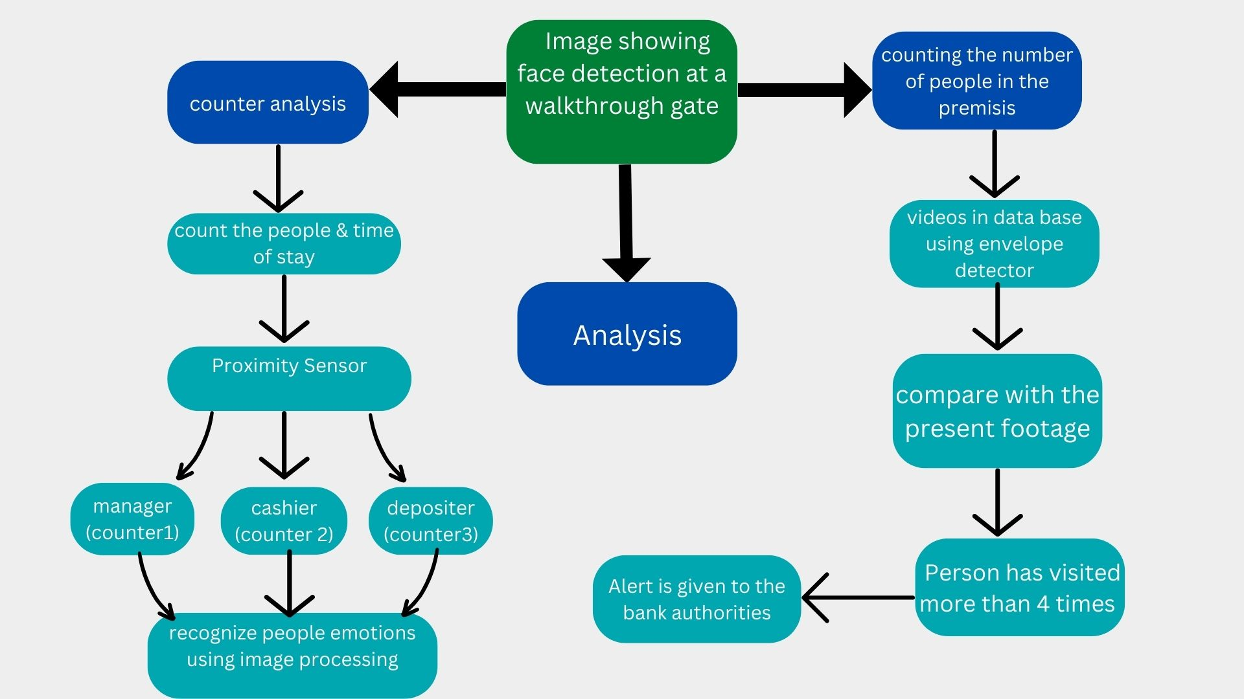
Key Differentiators & Adoption Plan

Slide 9
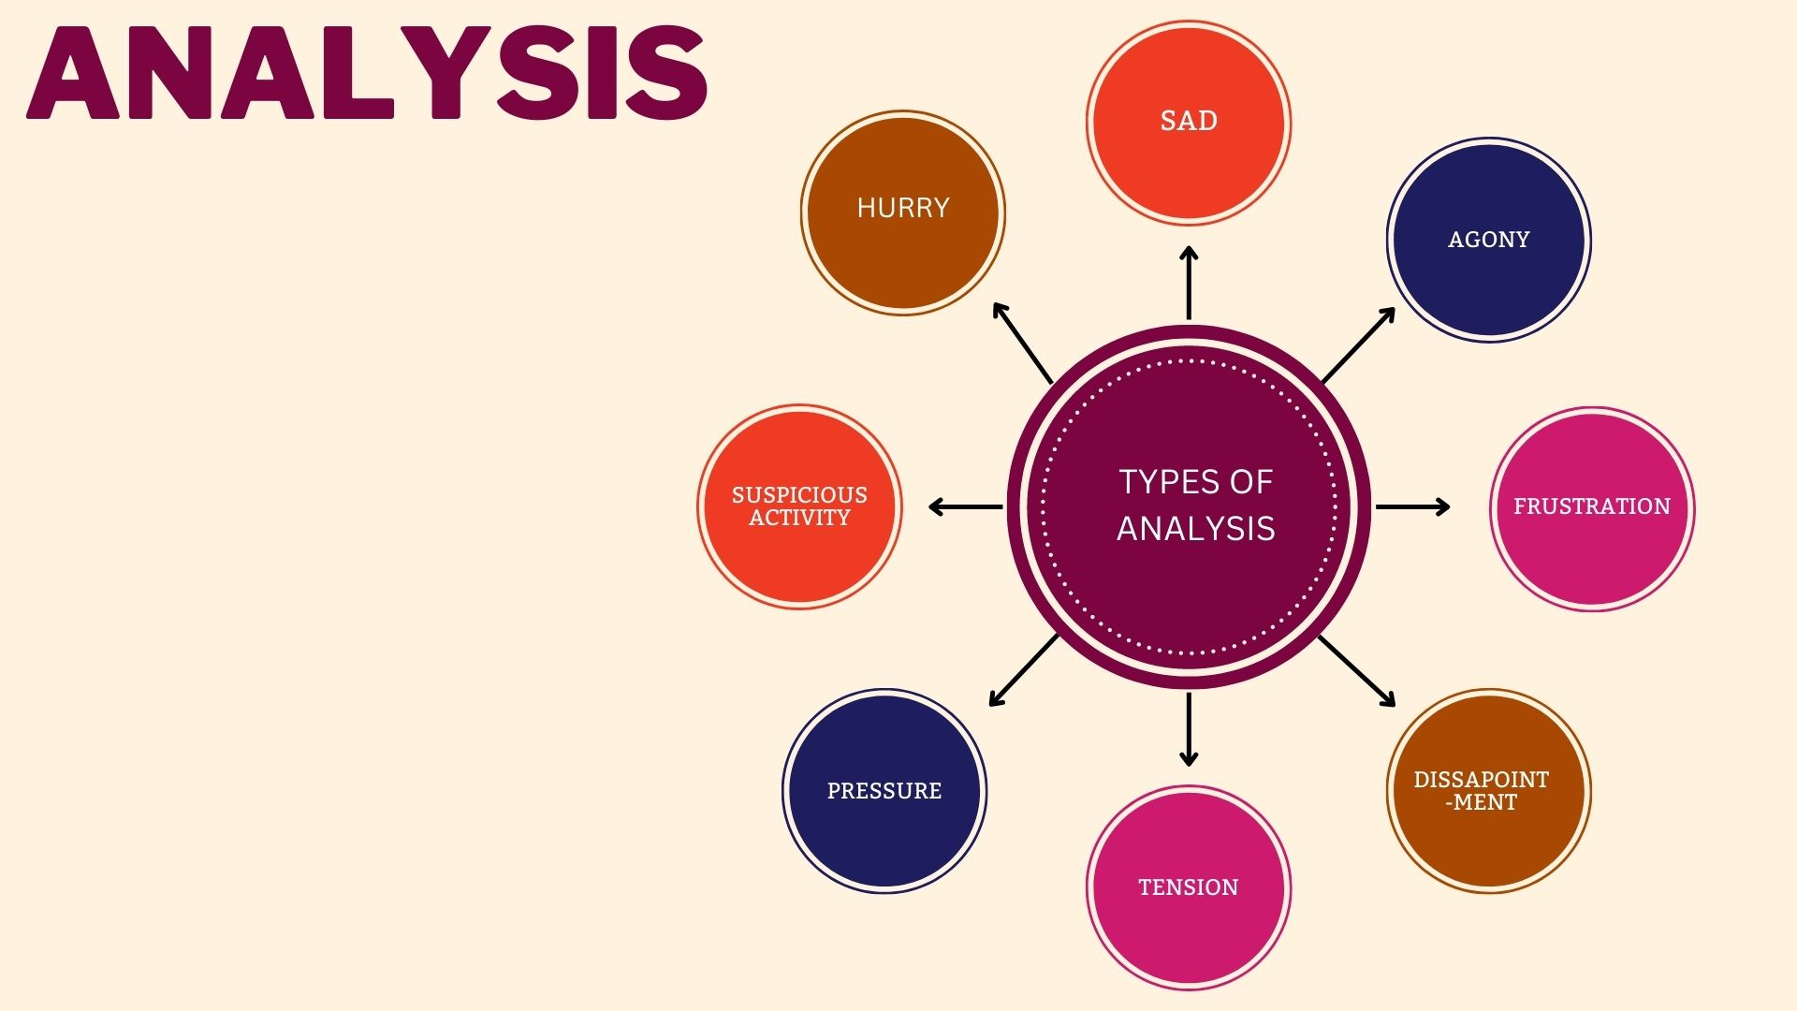

Slide 10
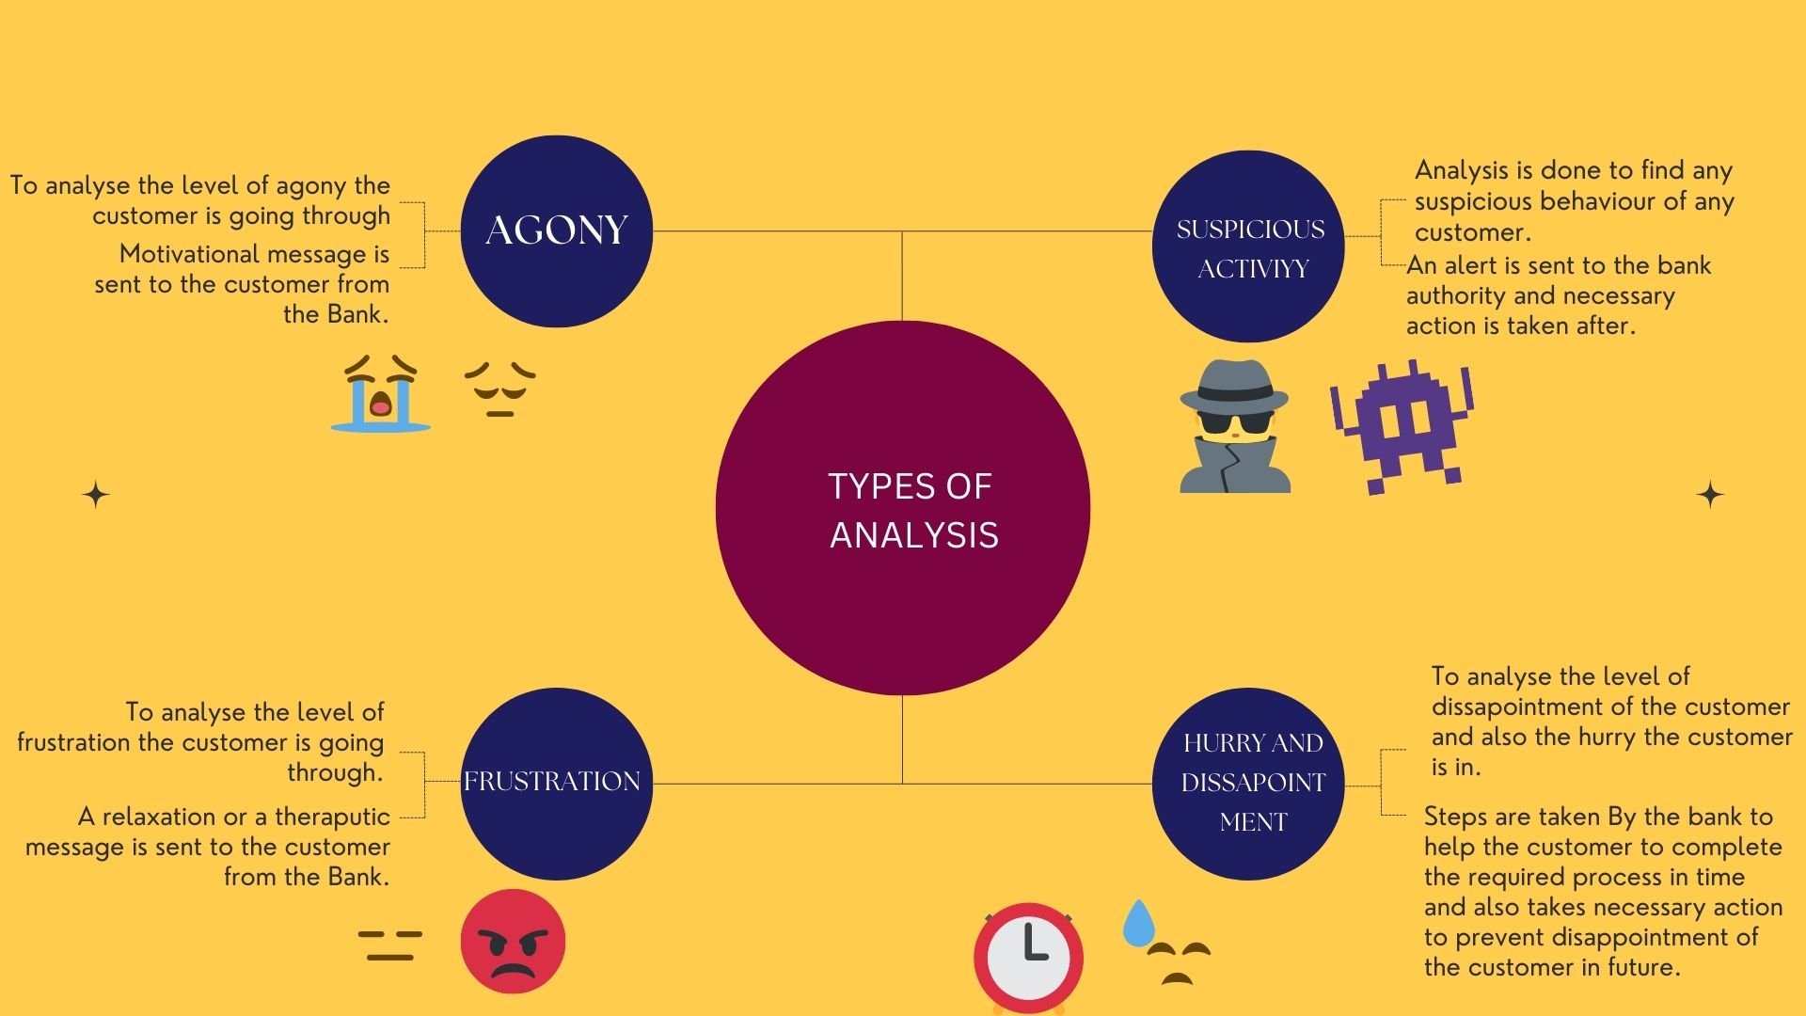

Slide 11
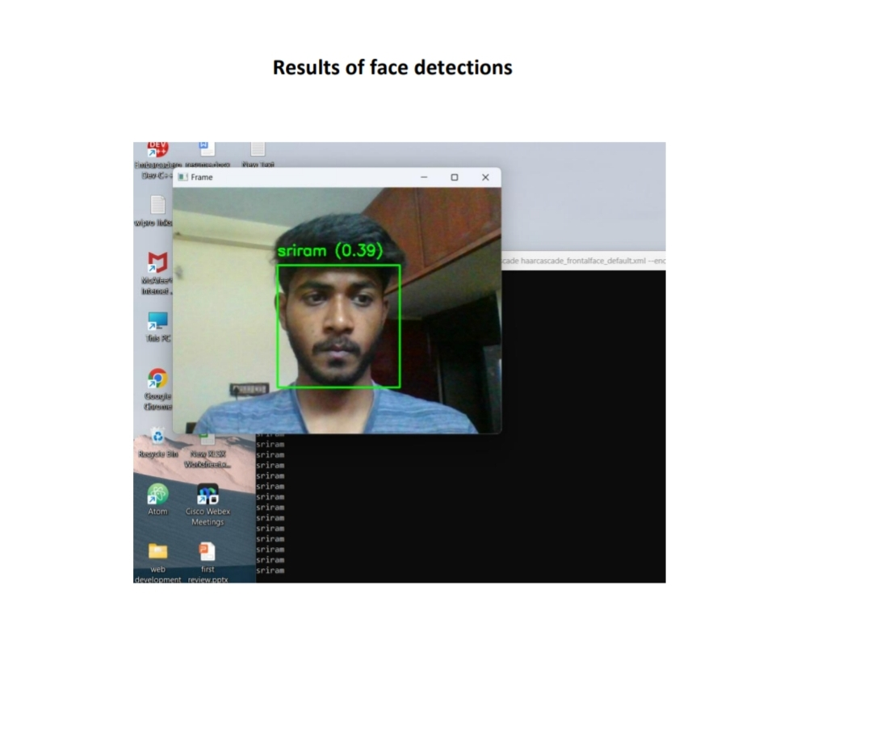
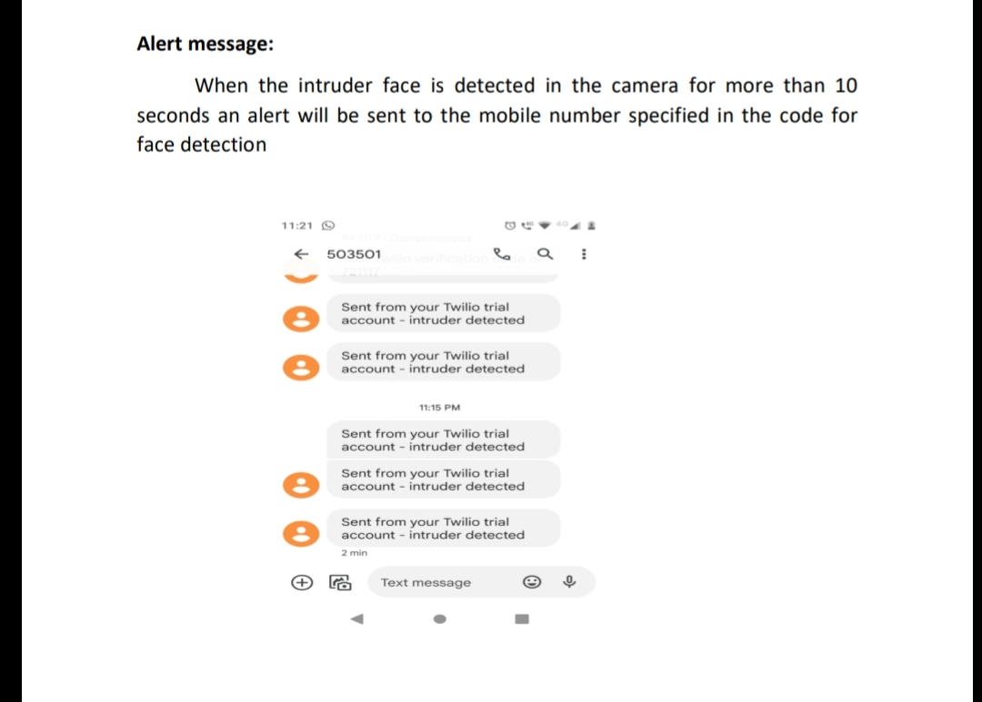
GitHub Repository Link and Screenshots
https://github.com/Yazhinimathivanan/facial-recognation/commit/946a87df96f3920dc638105358faaac14a48700b

Slide 12
Thank You
Team member names
Yazhini M S (312320106177)
Shweta S Menon (312320106144)
Sanjna R (312320106137)
Tasmiya Sulthana Z (312320106156)

